Slide 1
If interested in following along….
Install python
pip install nltk
In python
import nltk
nltk.download()
Models
maxent_ne_chunker
maxent_treebank_pos_tagger
Corpora
words

Slide 2
Get the most out of your text-based data
Amber McKenzie

Slide 3





Who am I?
Notes:
Without getting into the existential question, I’ll give you some superficial information about me.

Slide 4

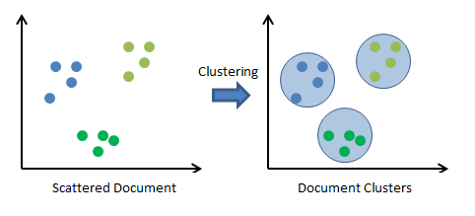


Projects

Slide 5
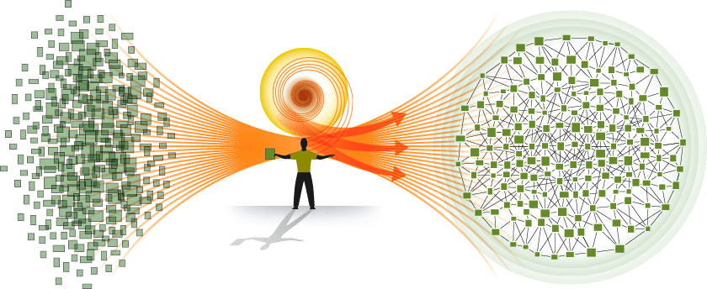
Agenda
Where does text fit into data analysis?
What is NLP?
How is NLP awesome?
How can I do NLP and text analysis by myself?

Slide 6


Reality
Digital universe will total 35 zettabytes in 2020 (in 2011 it was 1.8 zettabytes) [IDC 2011 Digital Universe Study]
80% of digital data is unstructured or text based data [2013 Forbes]
Structured
Unstructured
Notes:
Text-based data largely underutilized or ignored
Lack of understanding as to the capabilities and possibilities in text analysis

Slide 7
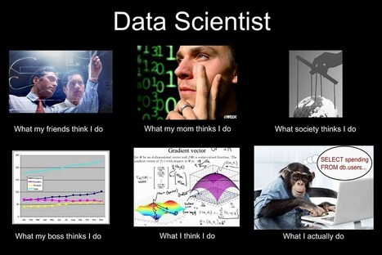
Notes:
The term “data analysis” refers to the process by which large amounts of raw data is reviewed in order to determine conclusions based on that data. The data is often unorganized, and may come from different sources.
Quantitative Analysis focuses on numbers and statistical modeling to determine correlations, error rates, operating norms, economic trends, and other measurable factors.
Qualitative Analysis focuses on observed patterns, quality of information, similarities and associations between data inputs, and other descriptive information.
Text analysis makes Qualitative Analysis faster and easier by analyzing unstructured text to enable insights into the content, subject matter, quality of data, intent or tone, etc.

Slide 8
Types of Text Data
Professional Journals
Websites
Customer Comments
Field Reports
Case Notes
Interview Transcripts
Invoices
Email
News Articles
Text Messages
Research Papers
Social Media

Slide 9


What are NLP and text analytics?
Natural language processing (NLP)
Based on linguistic features and information
Focused more on concepts and entities within text
Text analysis
Treats textual information as any other data
Focused more on statistical techniques and word frequencies
Notes:
Crunch time … Interactive portion of the presentation. Will they or won’t they talk?
Text analysis pares down large amounts of information
NLP focused more on information extraction

Slide 10



NLP – Solving the world’s problems
Notes:
Need to read up on these things so I can answer questions about them

Slide 11
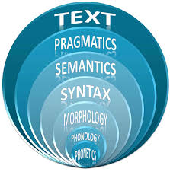
NLP basics
Tokenization
Part-of-speech tagging
Syntactic parsing
Chunking
Keyword extraction

Slide 12
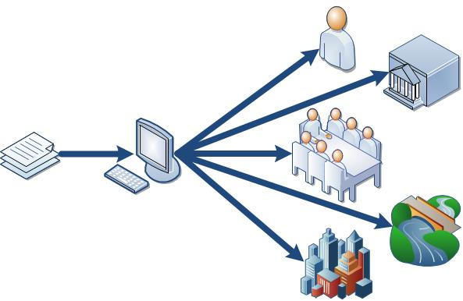
Named Entity Recognition (NER)
NER is key to finding and tagging relevant data “entities” (people, places, locations)
Number of effective models already trained and available
Stanford Named Entity Recognizer
Illinois Named Entity Tagger
AlchemyAPI
Mr. [PER Washington] took a late flight out of [LOC Washington, D.C.] on his way to [LOC Seattle] to meet with the owners of [ORG Washington Appliances, Inc.]
President Obama spoke with the CEO of Exxon Mobil Corporation, Rex Tillerson, about oil drilling in the Caspian Sea.
Mr. Washington took a late flight out of Washington, D.C. on his way to Seattle to meet with the owners of Washington Appliances, Inc.
President [PER Obama] spoke with the CEO of [ORG Exxon Mobil Corporation], [PER Rex Tillerson], about oil drilling in the [LOC Caspian Sea].

Slide 13



Other NLP and text analysis
Topic modeling
Timeline analysis
Sentiment analysis
Relation extraction
Coreference resolution
Text summarization
Notes:
Not exhaustive

Slide 14

AlchemyAPI
Multiple NLP functionalities
Simple API calls
Free API key
1000 daily transactions and 5 concurrent requests
Demo available
http://www.alchemyapi.com/products/demo/alchemylanguage/
Entity extraction
Sentiment analysis
Keyword extraction
Language detection
Text extraction
Concept tagging

Slide 15
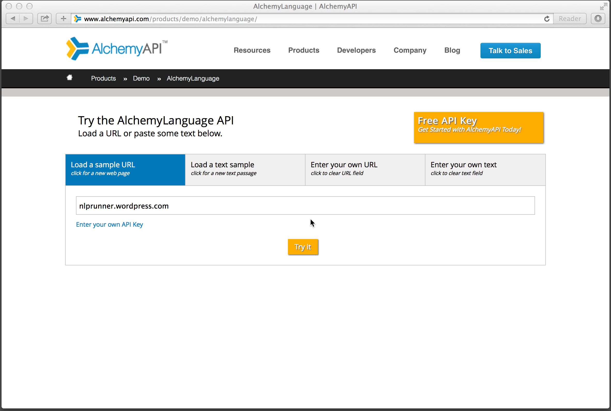

Slide 16
Stanford CoreNLP
Provides more of a linguistic analysis of a text
Java-based suite of tools
Online demo available
http://nlp.stanford.edu:8080/corenlp/
Named entity recognition
Part-of-speech tagging
Syntactic parsing
Coreference resolution
Sentiment analysis

Slide 17
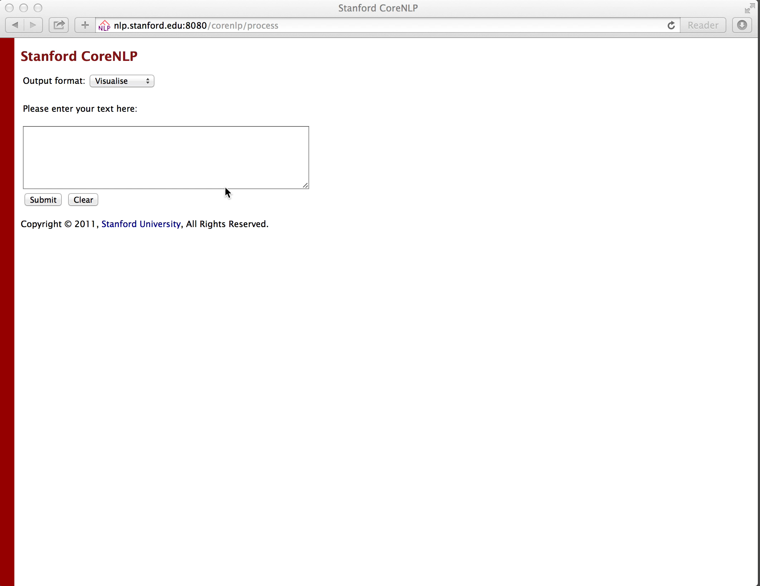

Slide 18

NLTK
Suite of text processing libraries
Number of available pre-built models and corpora
Easy to get started with basic NLP
Building blocks for more robust applications
Both linguistic and statistical analysis libraries

Slide 19

Goals
What questions do you want answered?
How can your data answer those questions?

Slide 20

Sentiment analysis on product reviews
How do people feel about my product?
Example:
Train model on movie reviews using NLTK
Scrape product reviews from Amazon
Tag new reviews using trained model

Slide 21
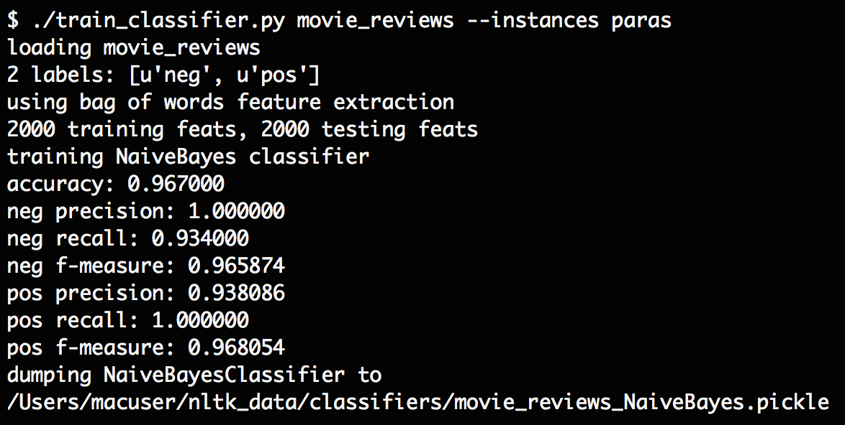
https://github.com/japerk/nltk-trainer

Slide 22
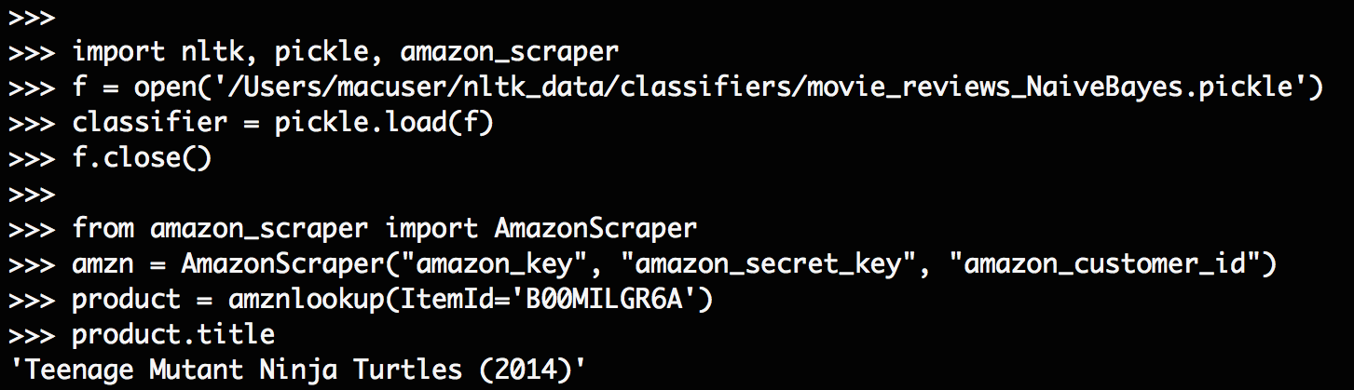

Slide 23
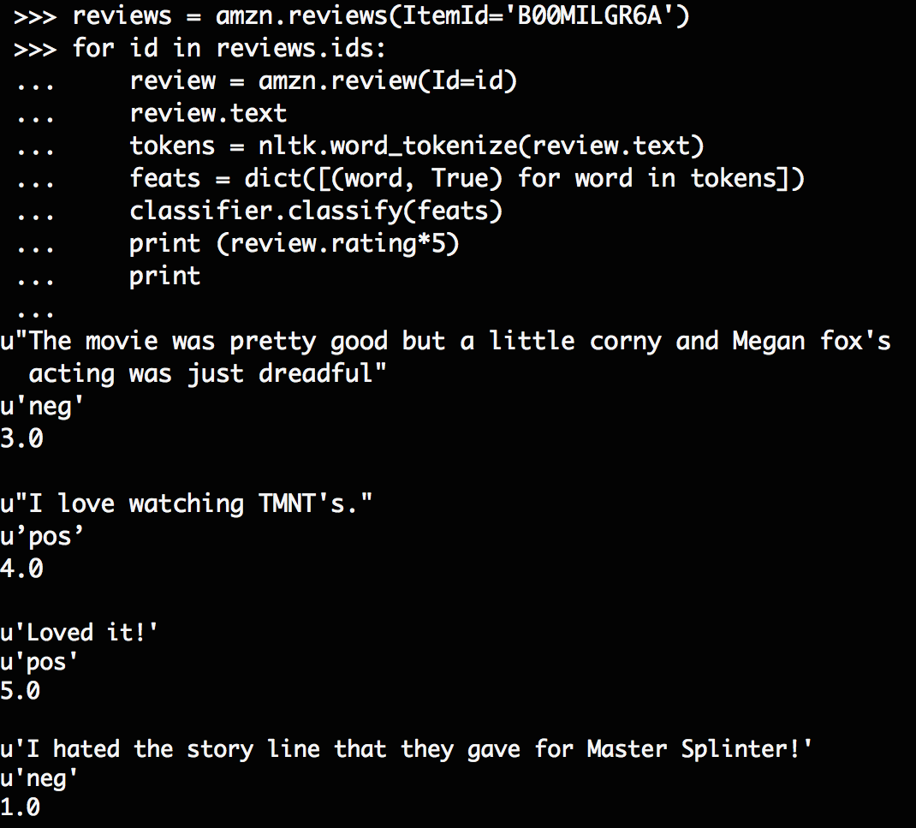

Slide 24
Tools and links
http://www.nltk.org/book/
http://www.alchemyapi.com/products/alchemylanguage/
http://nlp.stanford.edu/software/corenlp.shtml
http://cogcomp.cs.illinois.edu/page/software/
http://mallet.cs.umass.edu/

Slide 25

Contact information
Amber McKenzie, Ph.D.
Data Scientist
PYA Analytics
Knoxville, TN
www.pyaanalytics.com
amckenzie@pyaanalytics.com
mckenzie.amber@gmail.com

Slide 26
Questions?

Slide 27
Text for CoreNLP demo
“The long-sought after memristor–the “missing link” in electronic circuit theory–has been invented by Hewlett Packard Senior Fellow R. Stanley Williams at HP Labs (Palo Alto, California). Memristors–the fourth passive component type after resistors, capacitors and inductors–were postulated in a seminal 1971 paper in the IEEE Transactions on Circuit Theory by professor Leon Chua at the University of California (Berkeley), but their first realization was just announced today by HP. According to Williams and Chua, now virtually every electronics textbook will have to be revised to include the memristor and the new paradigm it represents for electronic circuit theory.”
Though success in this area threatens to cause serious problems for current cryptographic systems due to the ability for quantum computers to easily solve problems that are computationally intractable with current technology, this has not deterred research interest. Earlier this month, Australian scientists made significant headway in the competition to build a working quantum computer with advancements from two different research groups.
http://cdn.zmescience.com/wp-content/uploads/2011/04/quantum-computer.jpg“The advance by Dr Dzurak’s team involves placing a single electron – embedded in a silicon chip – in a “quantum state,” and then repeatedly measuring the state. In February, a second group based at the University of New South Wales published an article in the journal Nature Nanotechnology reporting their advance: the construction of a single-atom transistor using a different but related design approach.

